Slide 1
Introduction to Human Resource Management
Part 1 | Introduction
Chapter 1

Slide 2
After studying this chapter, you should be able to:
Explain what human resource management is and how it relates to the management process.
Give at least eight examples of how all managers can use human resource management concepts and techniques.
Illustrate the human resources responsibilities of line and staff (HR) managers.
Provide a good example that illustrates HR’s role in formulating and executing company strategy.
Write a short essay that addresses the topic: Why metrics and measurement are crucial to today’s HR managers.
Outline the plan of this book.
1–<number>

Slide 3





The Management Process
Planning
Controlling
Organizing
Leading
1–<number>

Slide 4
Human Resource Management at Work
What Is Human Resource Management (HRM)?
  The policies and practices involved in carrying out the “people” or human resource aspects of a management position, including recruiting, screening, training, rewarding, and appraising.
1–<number>

Slide 5


Human Resource Management at Work
Acquisition
Fairness
Training
Human
Resource Management
(HRM)
Health and Safety
Appraisal
Labor Relations
Compensating
1–<number>

Slide 6
Personnel Aspects of a Manager’s Job
Conducting job analyses
Planning labor needs and recruiting job candidates
Selecting job candidates
Orienting and training new employees
Managing wages and salaries
Providing incentives and benefits
Appraising performance
Communicating
Training and developing managers
Building employee commitment
1–<number>

Slide 7
Personnel Mistakes
Hire the wrong person for the job
Experience high turnover
Have your people not doing their best
Waste time with useless interviews
Have your company in court because of discriminatory actions
Have your company cited by labor inspectors for unsafe practices
Have some employees think their salaries are unfair and inequitable relative to others in the organization
Allow a lack of training to undermine your department’s effectiveness
Commit any unfair labor practices
1–<number>

Slide 8

Basic HR Concepts
The bottom line of managing: Getting results
HR creates value by engaging in activities that produce the employee behaviors that the company needs to achieve
its strategic goals.
1–<number>

Slide 9

Line and Staff Aspects of HRM
Line manager
  A manager who is authorized to direct the work of subordinates and is responsible for accomplishing the organization’s tasks.
Staff manager
  A manager who assists and advises line managers.
1–<number>

Slide 10
Line Managers’ HRM Responsibilities
Placing the right person on the right job
Starting new employees in the organization (orientation)
Training employees for jobs that are new to them
Improving the job performance of each person
Gaining creative cooperation and developing smooth working relationships
Interpreting the firm’s policies and procedures
Controlling labor costs
Developing the abilities of each person
Creating and maintaining department morale
Protecting employees’ health and physical condition
1–<number>

Slide 11
Human Resource Managers’ Duties
Line Function
Line Authority
Implied Authority
Coordinative Function
Functional Authority
Functions of
HR Managers
Staff Functions
Staff Authority
Innovator
Employee Advocacy
1–<number>

Slide 12
Human Resource Specialties
Recruiters
Employment/
Industrial Relations Specialist
Human Resource Development Specialists
Human Resource Specialties
Training Specialists
Job Analysts
Compensation Managers
Employee Welfare Officers
1–<number>

Slide 13
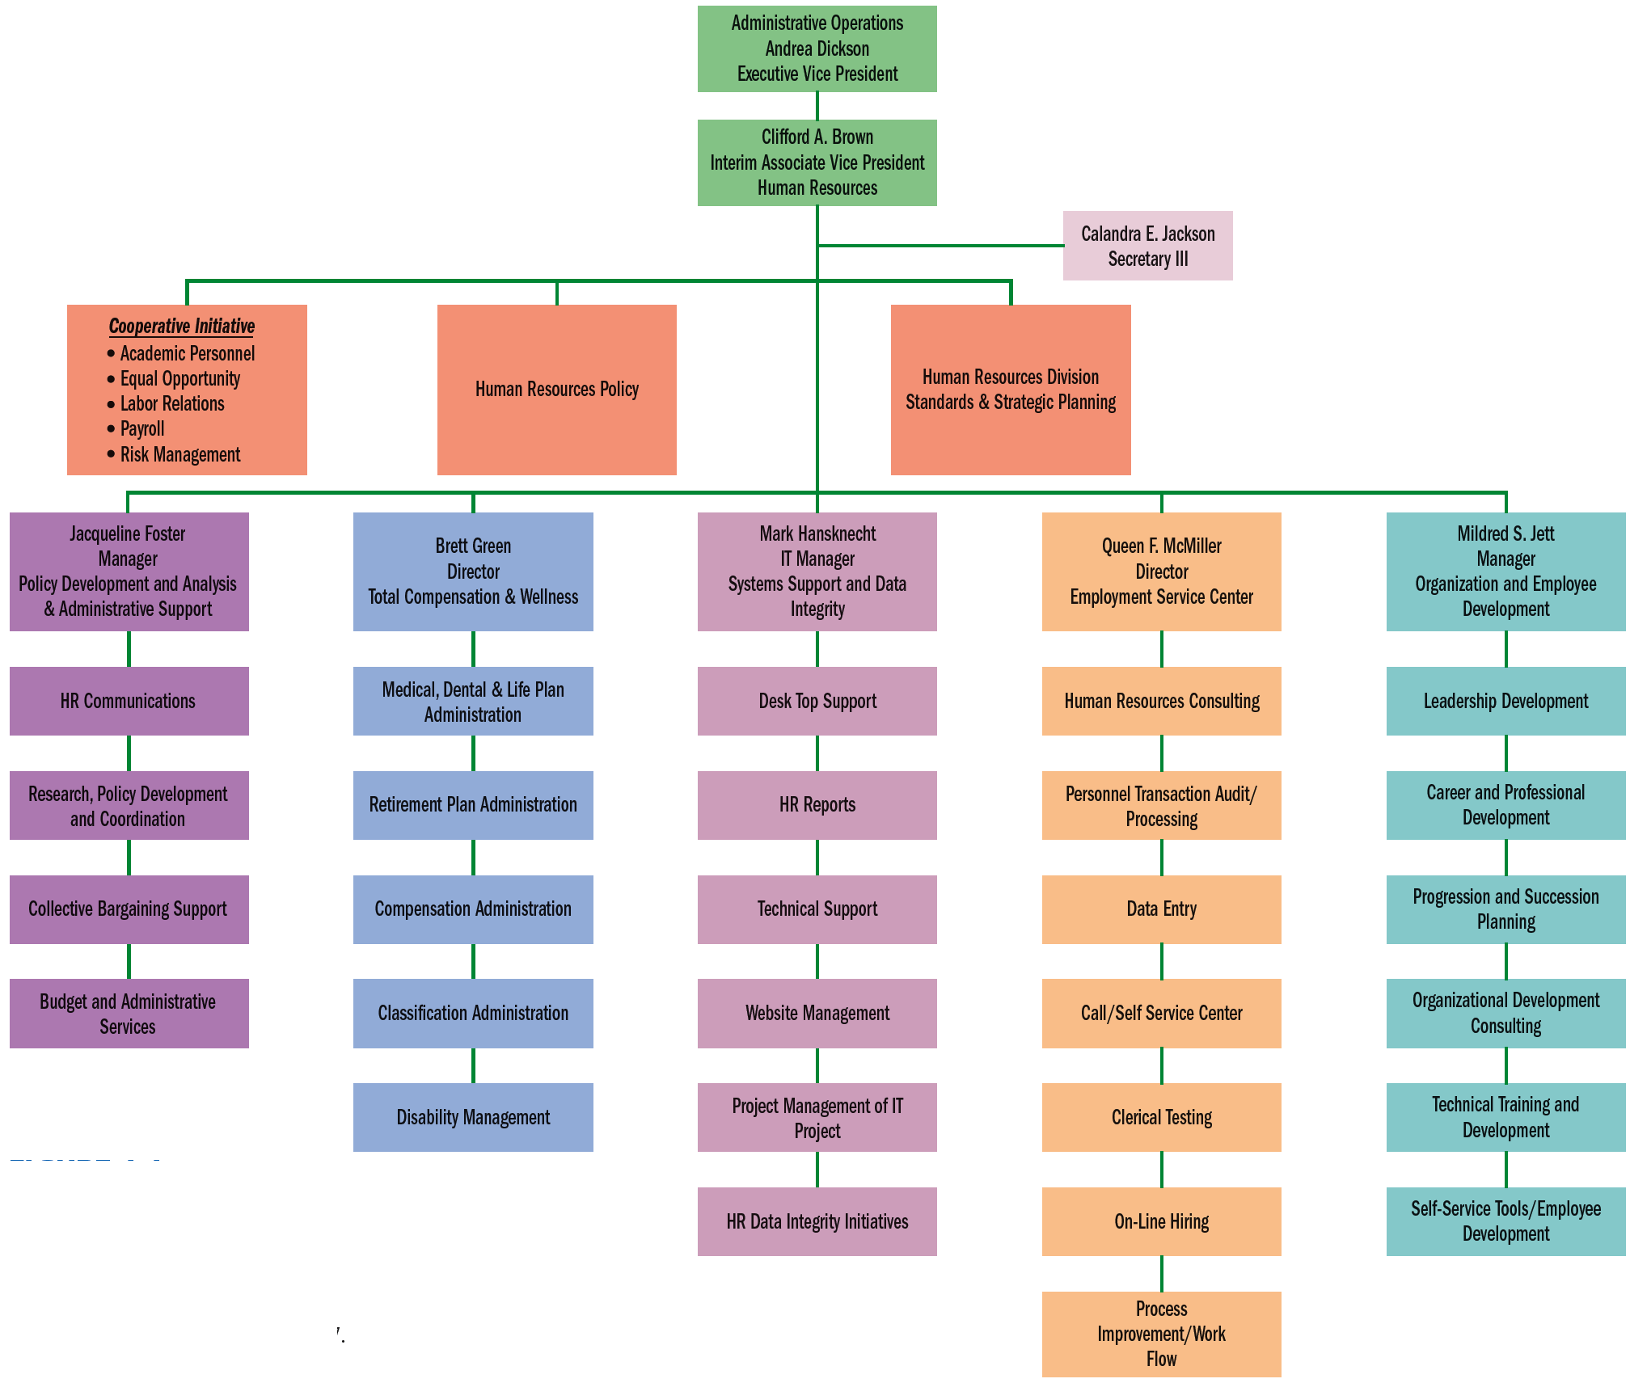
FIGURE 1–1
HR Organization Chart for a Large Organization
Source: www.hr.wayne.edu/orgcharts.php. Accessed May 6, 2007.
1–<number>

Slide 14
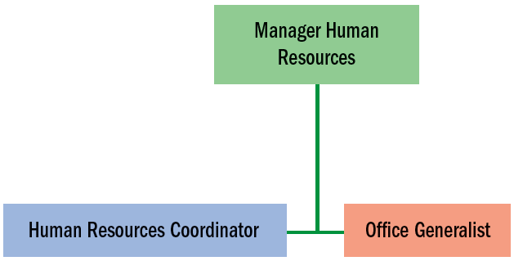
FIGURE 1–2 HR Organizational Chart (Small Company)
1–<number>

Slide 15


The Changing Environment of Human Resource Management
Globalization Trends
Changes and Trends in Human Resource Management
Technological Trends
Trends in the Nature of Work
Workforce Demographic Trends
1–<number>

Slide 16
The Changing Role of
Human Resource Management
Strategic Human Resource Management
Managing with the HR Scorecard Process
New Responsibilities for HR Managers
Creating High- Performance Work Systems
Measuring the HRM Team’s Performance
1–<number>

Slide 17
TABLE 1–2 Technological Applications for HR
Application Service Providers (ASPs) and technology outsourcing
Web portals
PCs and high-speed access
Streaming desktop video
The mobile Web and wireless net access
E-procurement
Internet- and network-monitoring software
Bluetooth
Electronic signatures
Electronic bill presentment and payment
Data warehouses and computerized analytical programs
1–<number>

Slide 18
High-Performance Work System Practices
Employment security
Selective hiring
Extensive training
Self-managed teams/decentralized decision making
Reduced status distinctions
Information sharing
Contingent (pay-for-performance) rewards
Transformational leadership
Measurement of management practices
Emphasis on high-quality work
1–<number>

Slide 19
Benefits of a High-Performance
Work System (HPWS)
Generate more job applicants
Screen candidates more effectively
Provide more and better training
Link pay more explicitly to performance
Provide a safer work environment
Produce more qualified applicants per position
Hiring based on validated selection tests
Provide more hours of training for new employees
Conduct more performance appraisals
1–<number>

Slide 20

The Human Resource Manager’s Proficiencies
New Proficiencies
  HR proficiencies
  Business proficiencies
  Leadership proficiencies
  Learning proficiencies
1–<number>

Slide 21
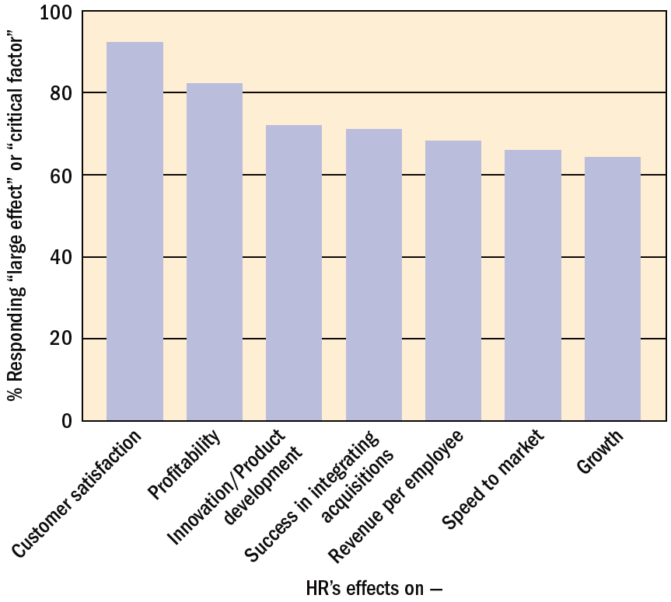
FIGURE 1–8 Effects CFOs Believe Human Capital Has on Business Outcomes
Source: Steven H. Bates, “Business Partners,” HR Magazine, September 2003, p. 49. Reproduced with permission of the Society for Human Resource Management via Copyright Clearance Center.
1–<number>

Slide 22

The Human Resource Manager’s Proficiencies (continued)
Managing within the Law
  Equal employment laws (US)
  Industrial Disputes Act of 1947
  Occupational safety and health laws
  Other labor laws
Managing Ethics
  Ethical lapses
  Sarbanes-Oxley in 2003
  Securities and Exchange Board of India (SEBI)
  Ministry of Corporate Affairs (MCA)
1–<number>

Slide 23
The Plan of This Book: Basic Themes
HRM is the responsibility of every manager.
HR managers must defend their plans and contributions in measurable terms.
All personnel actions and decisions have strategic implications.
All managers rely on information technology.
Virtually every personnel decision has legal implications.
1–<number>

Slide 24
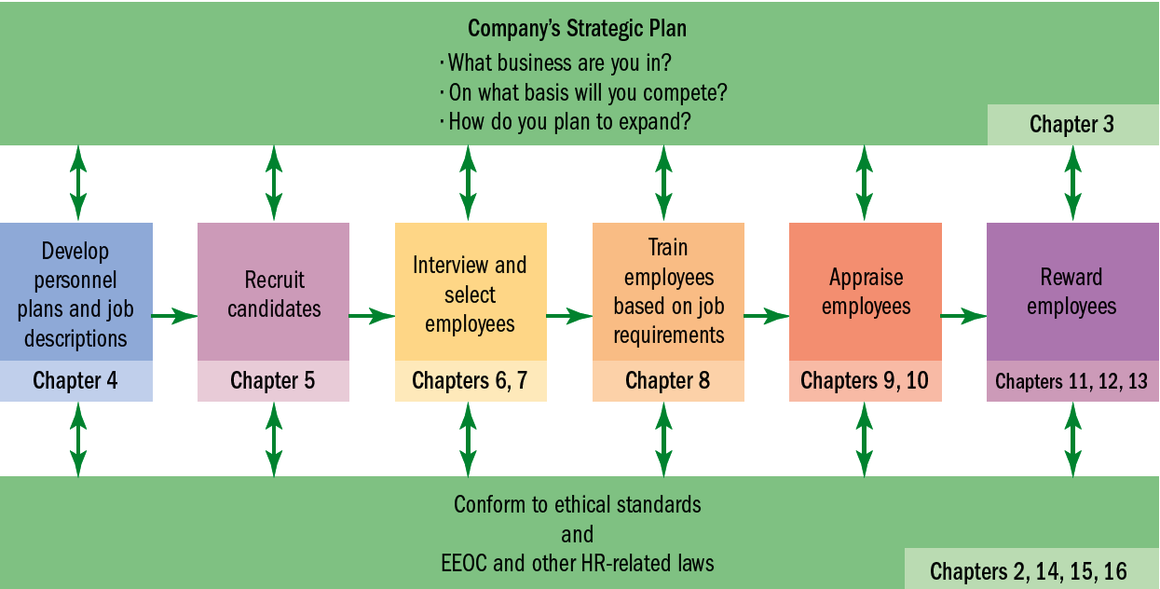
FIGURE 1–9 Strategy and the Basic Human Resource Management Process
1–<number>

Slide 25
K E Y T E R M S
management process
human resource management
(HRM)
authority
line manager
staff manager
line authority
staff authority
implied authority
functional control
employee advocacy
globalization
human capital
strategy
strategic plan
outsourcing
ethics
strategic human resource management
high-performance work system
1–<number>

Slide 26
Evolution and Challenges Faced in India
Part 1 | Introduction
Chapter 1 Appendix

Slide 27
HRM in India
In the 1970s and 1980s typical HRM functions in organization included:
  Personnel and administration
  Industrial relations
  Labor welfare
Up to the mid-80s human resource management in Indian organizations grew through various phases under the influence of the following factors:
  A philanthropic viewpoint about doing good for workers
  A legislative framework
  Government policies
  Trade unions
  Emerging trends/concepts in management
  Changes in the economy
1–<number>

Slide 28
Management Challenges for Indian CEOs
A study among Indian CEOs identified the following challenges:
  Creating a high-performance culture
  Retaining talent
  Recruiting
  Moving from a patriarchic and hierarchical management style to a more team-based, informal organizational culture
  Linking training with performance
  Compensating knowledge workers
  Building interpersonal relationships/managing conflict
  Going global
Source: Aneeta Madhok, “Similar Challenges” cited by Robert J. Grossman in “HR’s Rising Star in India,” available at http://www.shrm.org/india.
1–<number>

Slide 29
Shift to Human Resource Development Orientation
  The 1980s saw the large-scale introduction of the developmental concept in Indian organizations
  Udai Pareek and T. V. Rao, faculty of IIM Ahmedabad, introduced the human resource development (HRD) concept in India
1–<number>

Slide 30
Total Human Resource Management
  Opening up of the Indian economy created a demand for talent and the traditional organizations (both in public and private sectors) became talent sources.
  Development of the Information Technology sector mobilized a vast pool of technically trained people.
  Massive staffing requirements saw recruitment evolving as very specialized function, separate from but closely interlinked with the other HRM functions.
  Arrival of the “knowledge worker”—well-skilled, individualistic, and ambitious about career caused attrition to become common.
1–<number>

Slide 31
Total Human Resource Management (continued)
  Introduction of IT-supported solution, particularly ERP-based human resource information systems
  Introduction of innovative HR practices.
  Rise of IT-enabled services (ITES), gave employment opportunities to the young English speaking, educated population.
  HRM function assumed a strategic role in Indian organizations, responding to business requirements in an appropriate way.
1–<number>

